Slide 1

DEPARTMENT OF COMPUTER SCIENCE AND ENGINEERING
FACE AND HAND GESTURE
RECOGNITION SYSTEM FOR CONTROLLING VLC MEDIA PLAYER
under the guidance of
M.MADHUSUDHAN
(Associate professor)
BY
K.GOHATHI (197R1A05L7)
K.SAKETH REDDY (197R1A05L6)
K.PRADEEP (197R1A05M0)

Slide 2
ABSTRACT:
In human-computer interaction or sign language interpretation, recognizing hand gestures become predominant in computer vision research. The primary goal of this proposed system is to create a system, which can identify hand gestures detection to convey information for controlling media player. For those who are deaf and dumb sign language is a common, efficient and alternative way for talking, by using the hand and facial gestures we can easily understand them. Here hand and face are directly use as the input to the device for effective communication purpose of gesture identification there is no need of an intermediate medium. Gesture recognition affords real-time information to a computer to make it fulfill the user’s commands. It is an area of active current research in computer vision and machine learning. Generally, interaction between a computer and human is performed with a keyboard and mouse. However, to control and interact with a media player we are using a keyboard and mouse.. To make this interaction easier and more convenient without using extra devices such as keyboard and mouse, we propose to build gesture based interaction for controlling the media player gestures.

Slide 3
EXISTING SYSTEM:
In 2015, Chong Wang, “Super pixel-Based Hand Gesture Recognition with
Kinect Depth Camera” proposed the system which uses kinect depth camera. It is based on a compact representation in the form of super pixels, which efficiently capture the shape, texture and depth features of the gestures. Since this system uses kinect depth camera, the cost of system is more.

Slide 4
DISADVANTAGES:
Hand recognition has some technical issues based on image dataset loading.Delay in finding accuracy of face.
Huge storage requirements.
Potential privacy issues

Slide 5
PROPOSED SYSTEM:
The design for the proposed device is to stumble on hand gestures and control
the media participant without touching the keyboard. OpenCV is used to get admission to the video from a webcam. PyAutogui is used to configure the media player with the python code. This works properly with VLC media players and as a result, its miles counseled to use VLC. Get the video the usage of the cv2 video capture feature. Then follow blur and try to put off the noise from the historical past; the usage of cv2 gaussian blur. Dilate and erode are used to filter out the history noise. It hit upon a variety of fingers with the usage of angle ninety. Pyautogui is used to combine gestures with the keyboard. Data
acquisition: Done by using an in-constructed webcam at the computer. Segmentation: there are kinds of strategies used. Skin detection version for detection of hand place. Recognition phase: choice tree turned into used as a class tool.Windows interplay: deliver the suitable command to the windows participant in keeping with the regarded gesture

Slide 6
ADVANTAGES:
Users cannot miss any part of the video.
• The video stops as user changes their view from the video thereby no need of
users to keep on dragging back to the point from where they missed.
• You can also forward and backward the video if required.
• It saves time and electricity.
• It gives accurate result

Slide 7
HARDWARE REQUIREMENTS:
Processor : Intel Dual Core I5 and above
Hard disk : 8GB and above
RAM : 8GB and above
Input devices : Keyboard, mouse

Slide 8
SOFTWARE REQUIREMENTS:
Operating system : Windows 8 and above
Languages : Python, Html, CSS
Tools : Python IDEL3.8 version, Anaconda - Jupyter,Spyder

Slide 9
NOVELTY:
Hand gesture recognition in aspect to human machine interface is being
developed vastly in recent days. Because of the disturbance of lighting and
background being not plain, many visual hand gesture recognition systems operate or
show successful results only in restricted background. To recognize the various hand
gestures, we will build a non-complex and with greater speed motion history image
related system. In our system, we mainly focus on applying pointing behavior for the
human machine interface. Now days, the gesture recognition has been a new
developmental and experimental thing for most of the human related electronics. This
system allows people to operate electronic products more conveniently. In our system,
a gesture recognition method is to be build which will be an interface between human
machine interaction i.e. HMI.

Slide 10
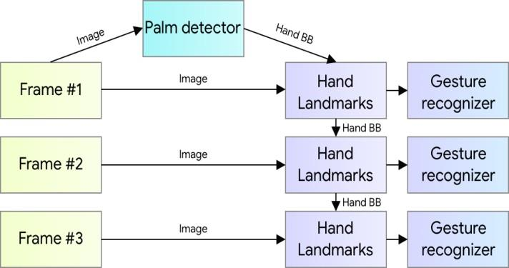
ARCHITECTURE
.

Slide 11
MODULE SPECIFICATIONS:
USER :The user controlles the VLc media Player by showing the hand
System : the system takes the input of the user and display the result by recognition of hand

Slide 12
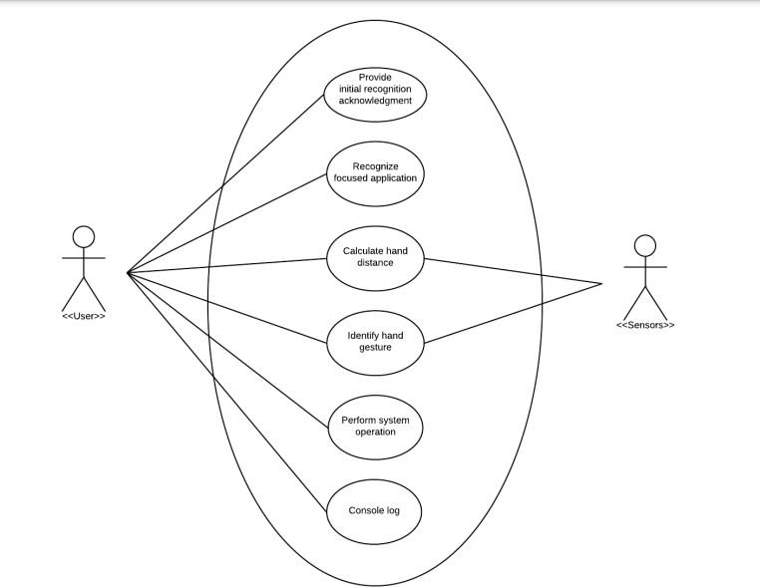
Use Case Diagram

Slide 13
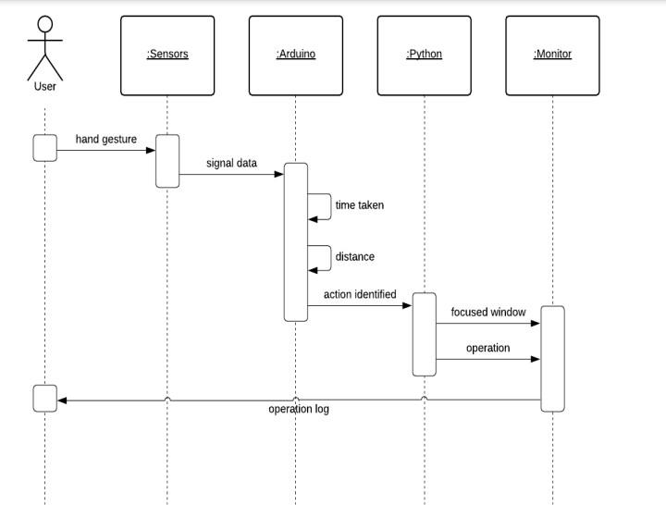
Sequence Diagram

Slide 14
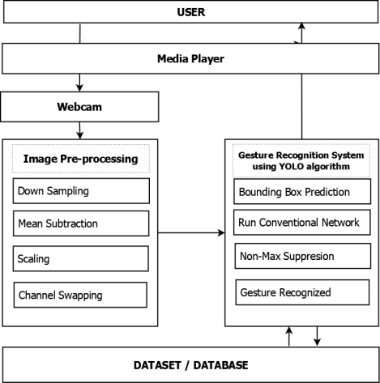
Activity Diagram

Slide 15
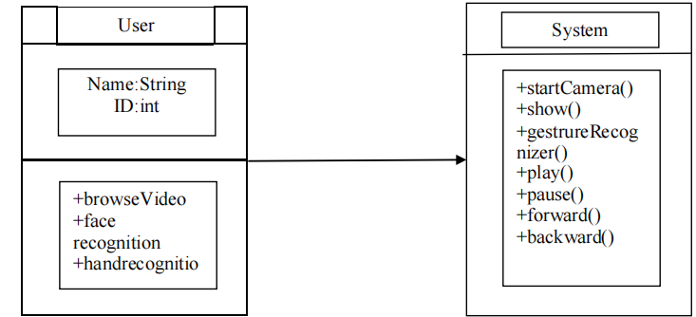
Class Diagram

Slide 16
SAMPLE CODE
class Control:
def init (self, media_path):
self.mp_drawing = mp.solutions.drawing_utils
self.mp_hands = mp.solutions.hands
with open('gesture_recognition_model.pkl', 'rb') as f:
self.model = pickle.load(f)
self.media_player = vlc.MediaPlayer()
self.media = vlc.Media(media_path)
self.media_player.set_media(self.media)
self.media_player.play()
time.sleep(2)
self.value = self.media_player.is_playing()
self.launch_cam()
# Pause video
def pause_gesture(self):
self.media_player.set_pause(1)

Slide 17
# Play video
def play_gesture(self):
self.media_player.play()
# Fast forward
def skip_forwards(self):
current_time = self.media_player.get_time()
self.media_player.set_time(current_time + 1000)
# Rewind
def skip_backwards(self):
current_time = self.media_player.get_time()
self.media_player.set_time(current_time - 1000)
# Increase volume
def vol_up(self):
value = self.media_player.audio_get_volume()
self.media_player.audio_set_volume(value + 1)
# Decrease volume
def vol_down(self):
value = self.media_player.audio_get_volume()
self.media_player.audio_set_volume(value - 1)

Slide 18
def launch_cam(self):
# start webcam with opencv
cap = cv2.VideoCapture(0)
# Use mediapipe Hands model
with self.mp_hands.Hands(
max_num_hands=2,
min_detection_confidence=0.5,
min_tracking_confidence=0.5) as hands:
while cap.isOpened():
success, image = cap.read()
if not success:
print("Ignoring empty camera frame.")
continue
# Convert to RGB and flip image so that camera output is like mirror.
image = cv2.cvtColor(cv2.flip(image, 1), cv2.COLOR_BGR2RGB)
image.flags.writeable = False
results = hands.process(image)

Slide 19
# Draw annotations
image.flags.writeable = True
image = cv2.cvtColor(image, cv2.COLOR_RGB2BGR)
if results.multi_hand_landmarks:FACIALRECOGNITION SYSTEM WITH VOICE MESSAGE ENHANCEMENT
CMRTC
17
for hand_landmarks in results.multi_hand_landmarks:
self.mp_drawing.draw_landmarks(
image, hand_landmarks, self.mp_hands.HAND_CONNECTIONS)
try:
# Get landmarks for hand 1
hand_1 = results.multi_hand_landmarks[0].landmark
landmarks_1 = list(
np.array([[landmark.x, landmark.y, landmark.z, landmark.visibility] for landmark
in hand_1]).flatten())

Slide 20
# get landmarks for hand 2
hand_2 = results.multi_hand_landmarks[1].landmark
landmarks_2 = list(
np.array([[landmark.x, landmark.y, landmark.z, landmark.visibility] for landmark
in hand_2]).flatten())
# Concatenate hand 1 and hand 2 data
data = landmarks_1 + landmarks_2
# Create pandas dataframe from data
X = pd.DataFrame([data])
# Make prediction
direction_gest = self.model.predict(X)[0]
# Annotate image with prediction text
cv2.putText(image, direction_gest.split(' ')[0]
, (90, 40), cv2.FONT_HERSHEY_SIMPLEX, 1, (0, 0, 0), 2, cv2.LINE_AA)

Slide 21
if direction_gest.split(' ')[0] == "Play":
self.play_gesture()
elif direction_gest.split(' ')[0] == "Stop":
self.pause_gesture()
elif direction_gest.split(' ')[0] == "Up":
self.vol_up()
elif direction_gest.split(' ')[0] == "Down":
self.vol_down()
elif direction_gest.split(' ')[0] == "Forwards":
self.skip_forwards()
elif direction_gest.split(' ')[0] == "Back":
self.skip_backwards()
except:
pass
# Show image
cv2.imshow('Gesture Controller', image)
if cv2.waitKey(10) & 0xFF == ord('q'):
break
cap.release()
cv2.destroyAllWindows()

Slide 22
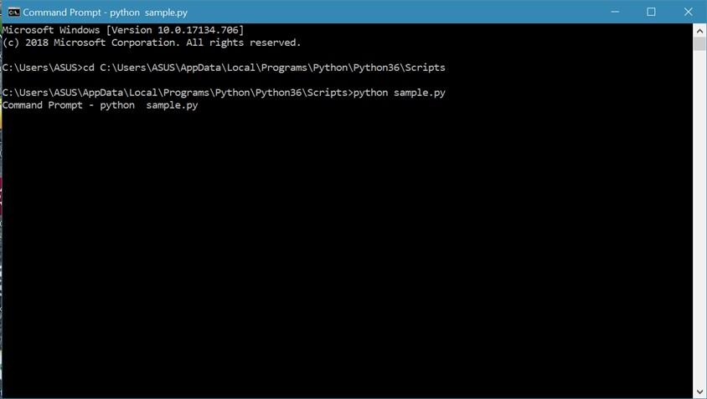
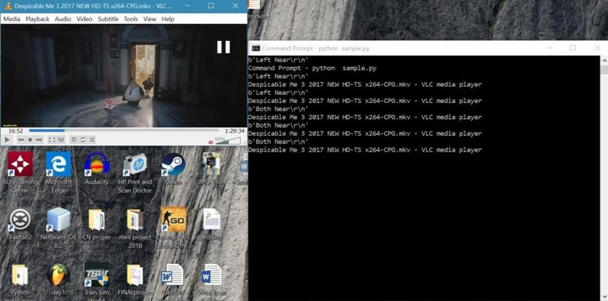
SCREENSHOTS:

Slide 23
CONCLUSION:
In the current world many resources are available to provide input to any
application some require physical touch and some without the use of physical touch (speech, hand touch etc.), the user can manage the system remotely without using the keyboard and mouse. This application provides a novel human computer interface where the user can control the media player (VLC) using hand gestures. The system specific touch to control the VLC player functions.

Slide 24
FUTURE ENHANCEMENT
To overcome the drawbacks of the current system, we can modify it for better.
While the application is running, if the user brings the hand closer to his/her face, not
intending to command the application, it nonetheless recognizes it and accordingly alters
the volume or seek controls. To avoid this, we can integrate iris detection to this project
to make it run more smoothly. In these times of the Pandemic, where we are cautioned
about everything we touch in a public place, this project can be extended to other public
service technical systems to avoid direct contact. ATM machines, Ticket Counters, etc
can make use of the extended version To overcome the drawbacks of the current system, we can modify it for better.While the application is running, if the user brings the hand closer to his/her face, not
intending to command the application, it nonetheless recognizes it and accordingly alters
the volume or seek controls. To avoid this, we can integrate iris detection to this project
to make it run more smoothly. In these times of the Pandemic, where we are cautioned
about everything we touch in a public place, this project can be extended to other public
service technical systems to avoid direct contact. ATM machines, Ticket Counters, etc
can make use of the extended version

Slide 25
REFERANCE
Muhler, Vincent. (2017, Sep 5). Simple Hand Gesture Recognition using OpenCV and JavaScript. Retrieved from https://medium.com/@muehler.v/simple-hand-gesture- recognition-using-opencv-and-javascript-eb3d6ced28a0
Circuito Team. (2018, Mar 11). Everything You Need to Know About Arduino Code.
Retrieved from https://www.circuito.io/blog/arduino-code/
Python Programming Language. (n.d.). Retrieved from https://www.geeksforgeeks.org/python-programming-language/
Data-flow diagram. (2019, May 3). Retrieved from https://en.wikipedia.org/wiki/Data- flow_diagram
Unit Testing. (n.d.). Retrieved from http://softwaretestingfundamentals.com/unit- testing/

Slide 26
THANK YOU

